Slide 1

Warm Up
Project Exercises

Slide 2
Complete Python Bootcamp
We’re almost ready for you to begin creating a full, interactive Python program.
For your upcoming milestone project you will be creating an interactive Tic Tac Toe game!

Slide 3
Complete Python Bootcamp
In order to “warm up” for this project, we’re going to code along with a few exercises in order for you to see how to use Python code to the following:
Grab user input
Manipulate a variable based on input
Return back adjusted variable

Slide 4
Complete Python Bootcamp
Visual Representation

Slide 5
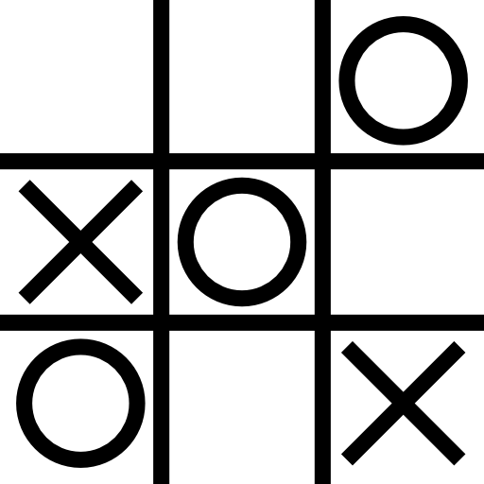
Complete Python Bootcamp
Visual Representation

Slide 6
Complete Python Bootcamp
Visual Representation
User Input

Slide 7
Complete Python Bootcamp
Visual Representation
User Input

Slide 8
Complete Python Bootcamp
Function
Visual Representation
User Input

Slide 9
Complete Python Bootcamp
Function
Visual Representation
User Input
Updates

Slide 10
Complete Python Bootcamp
Function
Visual Representation
User Input
Updates
New Visual

Slide 11
Complete Python Bootcamp
Function
Updated Visual Representation
User Input
Updates
New Visual

Slide 12
Complete Python Bootcamp
Most programs that are interactive work on this very simple idea.
Display something visual to the user
Let the user update through an interaction
Update variables in the program
Display updated visual

Slide 13
Complete Python Bootcamp
In the next series of short lectures, we will guide you through examples of how to perform these tasks with Python.
Keep in mind, there are many different ways of performing the same task, so don’t feel restricted by the examples we show here.

Slide 14
Displaying
Information

Slide 15
Accepting
User Input

Slide 16
Validating
User Input

Slide 17
Complete Python Bootcamp
We’ve seen how to use input() to interact with a user and how to convert the string data type into another type, such as an integer.
Let’s now explore how to further validate user input to avoid errors for invalid conversions.

Slide 18
Simple User
Interaction

Slide 19
Complete Python Bootcamp
To put everything together, let’s create a simple interactive program.
The program will
Display a list
Have a user choose an index position and an input value
Replace value at index position with user’s chosen input value

Slide 20
Complete Python Bootcamp
Let’s see what the finished game looks like, and then construct it ourselves using the functions we’ve already made!

Slide 21
Milestone Project 1
Overview

Slide 22
Complete Python Bootcamp
By now you should have gone through the “warm-up” project, covering:
Displaying Information
Accepting and Validating Input
Simple User Interactions

Slide 23
Complete Python Bootcamp
You now know enough to create a real program!
For your first milestone project you will create a Tic Tac Toe game for 2 human players.
Let’s describe what the game will be like...

Slide 24
Complete Python Bootcamp
2 players should be able to play the game (both sitting at the same computer)
The board should be printed out every time a player makes a move
You should be able to accept input of the player position and then place a symbol on the board

Slide 25
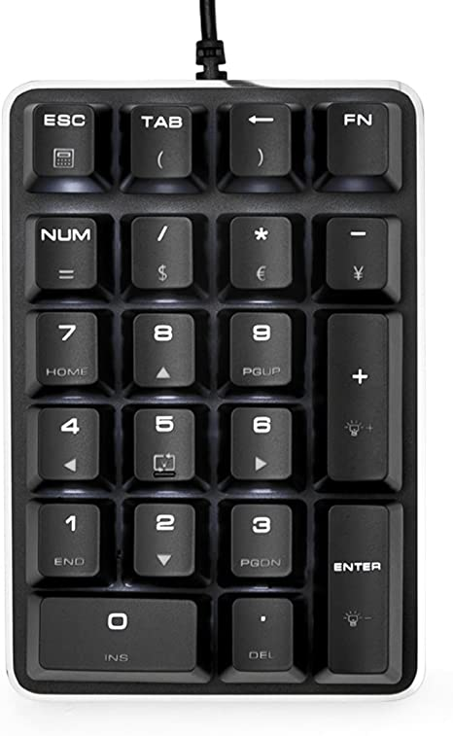
Complete Python Bootcamp
We will use the “numpad” to match numbers to the grid on a tic tac toe board:

Slide 26
Complete Python Bootcamp
We will use the “numpad” to match numbers to the grid on a tic tac toe board:
7 | 8 | 9
4 | 5 | 6
1 | 2 | 3

Slide 27
Complete Python Bootcamp
We will use the “numpad” to match numbers to the grid on a tic tac toe board:
7 | 8 | 9
4 | 5 | 6
1 | 2 | 3

Slide 28
Complete Python Bootcamp
We will use the “numpad” to match numbers to the grid on a tic tac toe board:
1

Slide 29
Complete Python Bootcamp
We will use the “numpad” to match numbers to the grid on a tic tac toe board:
X

Slide 30
Complete Python Bootcamp
We will use the “numpad” to match numbers to the grid on a tic tac toe board:
 | 8
X

Slide 31
Complete Python Bootcamp
We will use the “numpad” to match numbers to the grid on a tic tac toe board:
 | O
X

Slide 32
Complete Python Bootcamp
Creating your first full program is always a big leap, but you will come out the other end a much better programmer!
We’ve set up a walkthrough notebook for you to help guide you along with the functions you will need to create.

Slide 33
Complete Python Bootcamp
Let’s explore what the game will look like once it is done
We’ll also cover a few useful functions and go through the walkthrough notebook.
Let’s get started!

Slide 34
Milestone Project 1
Solutions for Workbook

